Slide 1
UE19CS345 – Network Analysis and Mining
Course Project
Project Title : Polypharmacy side-effect Association Network Analysis
Team members:
Abhishek V PES2UG19CS012
Balendra DP PES2UG19CS100
Ujwal Kundur PES2UG19CS197
Kuntal Gorai PES2UG19CS198

Slide 2
Topic and its uniqueness
Problem Statement:
Polypharmacy deals with use of multiple medications and their effects. In this project we identify various types of side effects that occur by consuming multiple drugs that interact with each other by using graph analysis and prediction methodologies.

Slide 3
What we are attempting to do?
We analyse the interaction of drugs with other drugs we can also predict the side effects caused based on this interaction
Finding the degree of centrality we identify which has the highest influence on the network that is the amount of side effect present in a particular drug

Slide 4
Dataset
About the dataset
This is a network of polypharmacy side-effects. Nodes represent drugs and edges represent different types of side effects that are associated with drug pairs. Edges indicate which side effects a patient will likely experience if he takes two drugs together (i.e., a drug combination). Such side effects are known as polypharmacy side-effects, as they are associated with drug pairs (or higher-order drug combinations) and cannot be attributed to either individual drug in the pair (in a drug combination).
Dataset statistics
Nodes 645
Edges 63473
Number of triangles 11489282

Slide 5
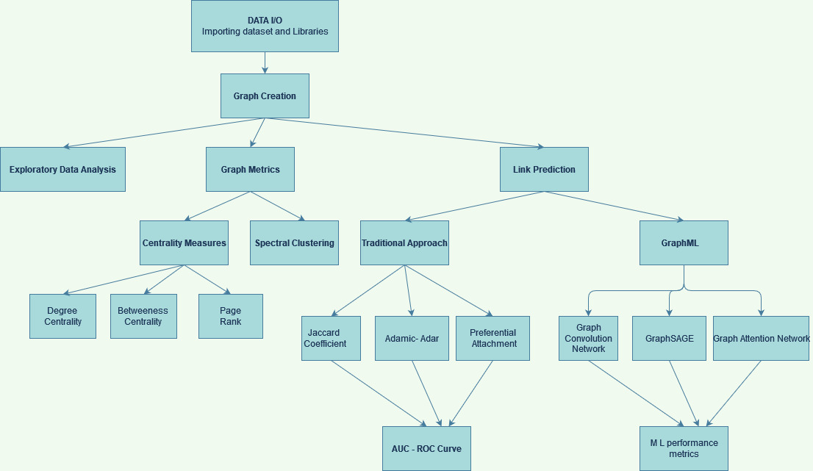
Overall design or Approach
Project Workflow:

Slide 6
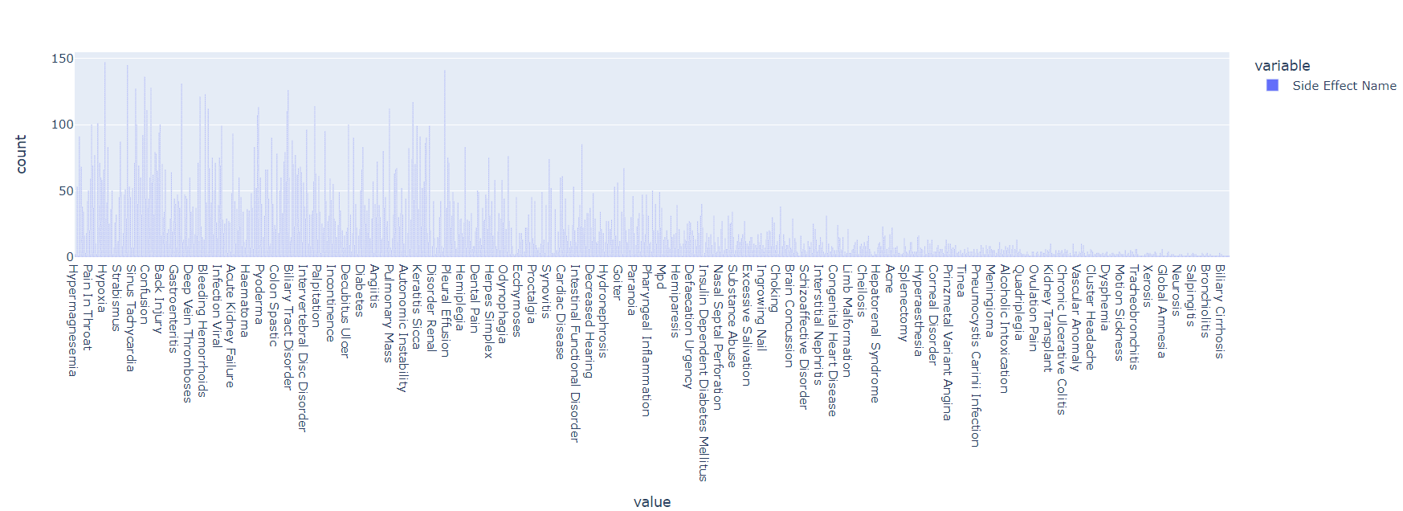
Final results
Side effects caused by various polypharmacy drug interactions:

Slide 7
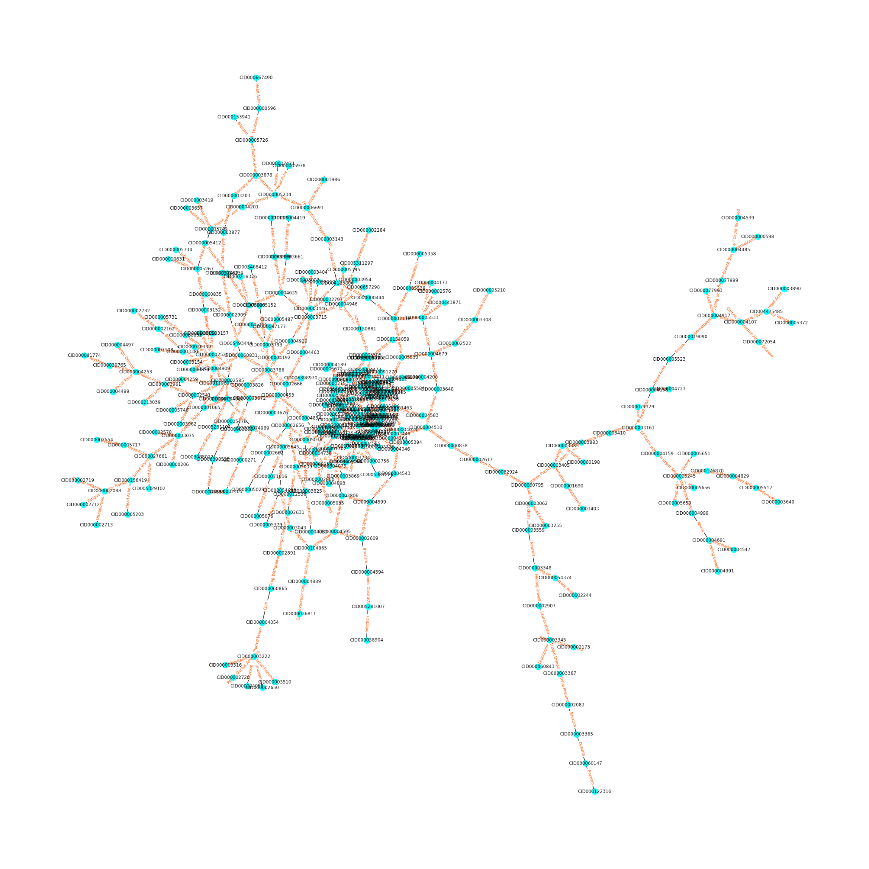
Drug Network

Slide 8
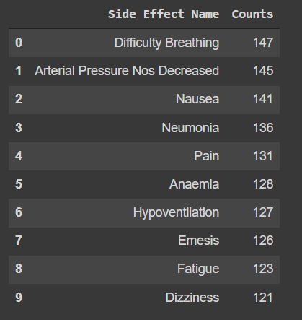
Top side effects arising from polypharmacy drug-drug interactions
Here we can see that difficulty in breathing is the most common side effect

Slide 9
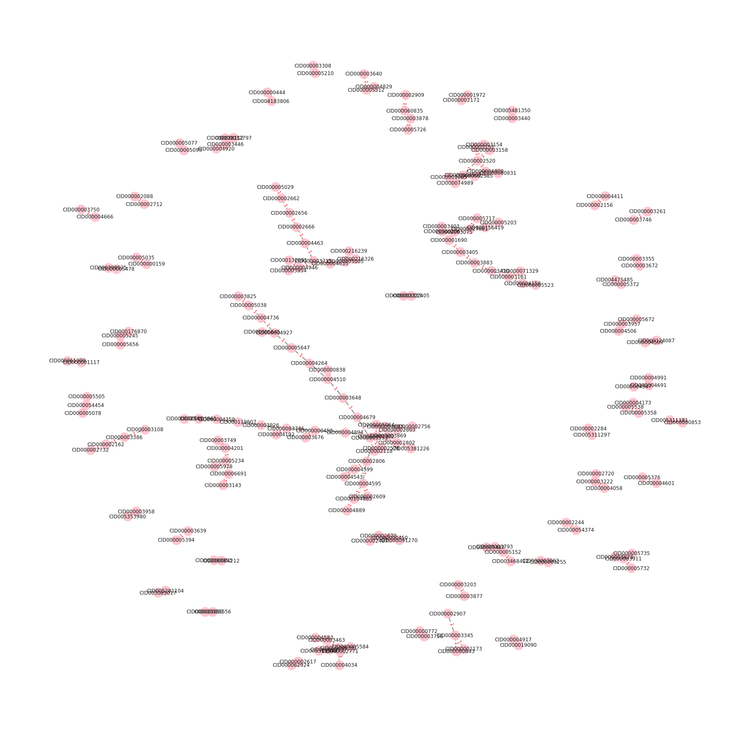
Graph depicting drug interactions that cause a polypharmacy side effect of difficulty in breathing

Slide 10
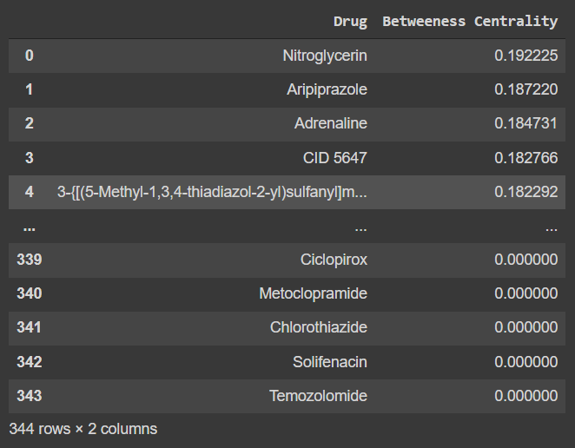
Centrality Measures
Betweeness Centrality
Analysis - The drug Nitroglycerin has highest betweeness centrality i.e it has highest amount of influence for flow of side effects in a graph.

Slide 11
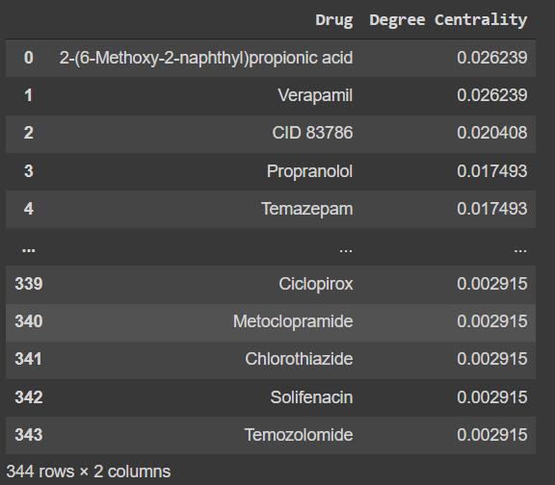
2. Degree Centrality
TAnalysis - The node 2-(6-Methoxy-2-naphthyl)propionic acid (Common drug name : Naproxen ) and Verapamil has a larger than average number of connections for this graph.

Slide 12
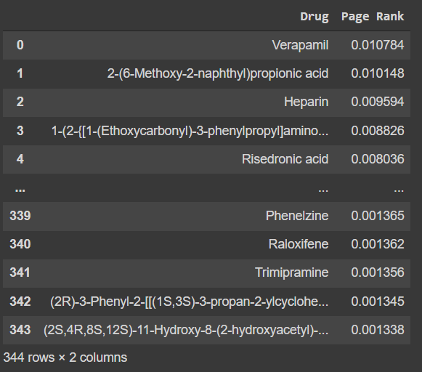
3. Eigen Value Centrality - Page Rank
Analysis - The drug verapamil has the highest influence in the given network

Slide 13
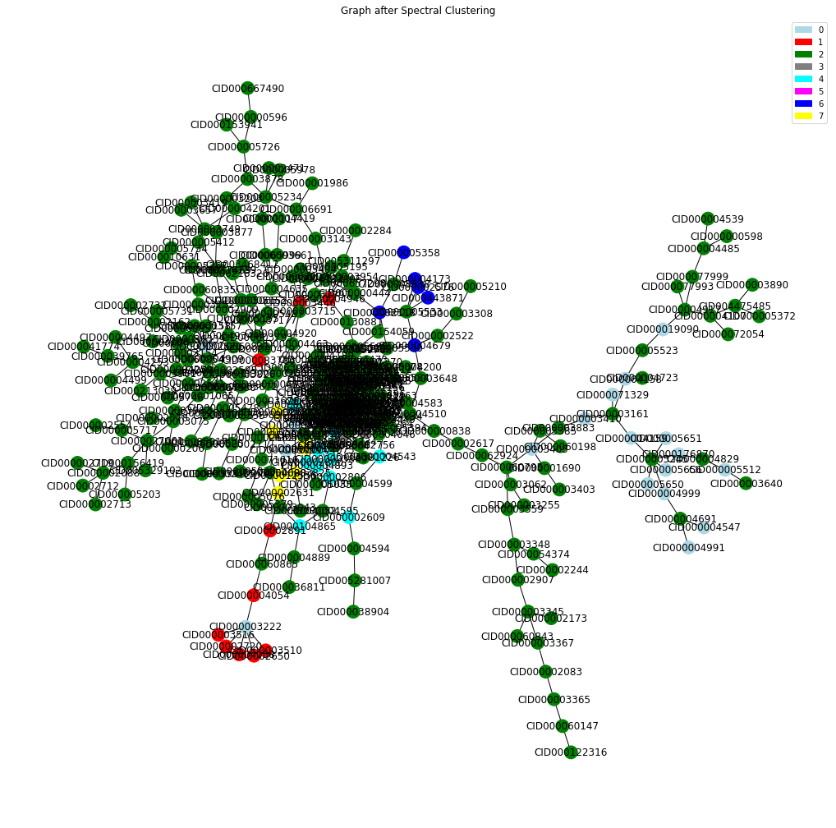
Spectral Clustering
Analysis - We see that using spectral clustering we were able to classify our graph into 8 different communities.This helps in finding similarities among nodes is high if they are belonging to the same community

Slide 14
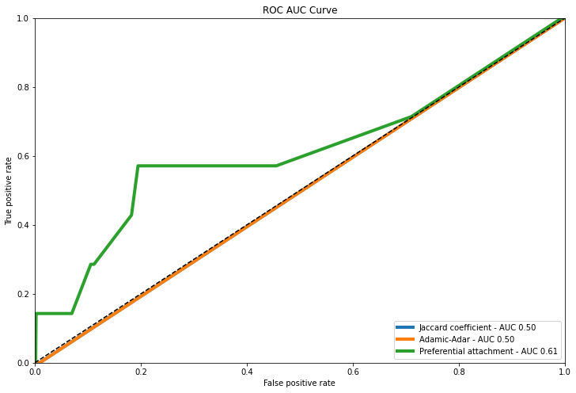
Link prediction with traditional Machine Learning
ROC - AUC Curve
Proximity based likelihood approach
Jaccard Coefficient
Adamic-Adar Similarity
Preferential Attachment
Analysis - From the AUC curve we see that best performance is by Adamic Adar similarity and Jaccard coefficient which have the highest coefficient.There is no significant large neighbourhood that is not dominating the prediction because jaccard takes common neighbours into consideration.

Slide 15
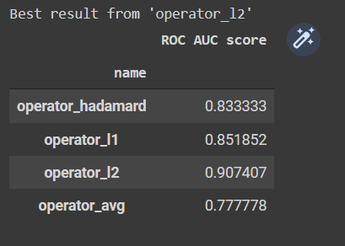
Link prediction with Node2Vec Model
ROC - AUC Scores for edge embeddings
4 different operators were considered for calculating edge embeddings
Hadamard
L1
L2
Average
Analysis - From the ROC AUC scores we see that best performance is by L2 operator on two nodes to calculate edge embeddings from node embeddings

Slide 16
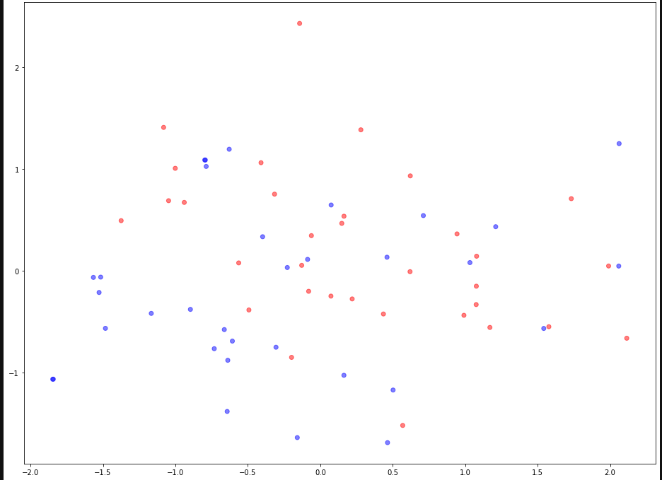
Link prediction with Node2Vec Model
Visualization of predicted link embeddings
We use PCA to project edge embeddings in 128 dimensions to 2 dimensions for visualization. The blue points are predicted to be positive (Edge exists between 2 drugs) and red points are predicted to be negative (No edge exists between the 2 nodes)

Slide 17
Quantity and quality of work
no | Code functionality | % Complete | Runs without problem (Y/N) | If there are minor issues, indicate
1 | Introduction and Problem Statement | 100 | Y
2 | Data IO and Graph Creation | 100 | Y
3 | Exploratory Data Analysis | 100 | Y
4 | Graph Metrics | 100 | Y
5 | Link Prediction and Analysis using Traditional Similarity based Techniques | 100 | Y
6 | Link Prediction and Analysis using Graph ML Techniques | 100 | Y
7 | Conclusion and Report | 100 | Y

Slide 18
Top few learning
Serial No | Top learning in this project
1 | Learned how to make use of the networkx package to create graph,perform centrality measures and perform spectral clustering.
2 | Learnt about how traditional methods perform link prediction and its performance measures.We saw jaccard coefficient and adamic adar were good models for the graph.
3 | Explore modern neural methods of learning on graphs – representation learning and semi-supervised graph algorithms using neural techniques
4 | Explored node2vec model helping to perform node embedding and then perform a link prediction on it.

Slide 19
Top unresolved challenges
Serial No | Brief description of unresolved challenges | Type of challenge (scope/data/design/implementation / others)
1 | Wasn’t able to perform graph ml models like gcn,graphSAGE and GAT models in our project due to data not matching with the model requirements. | Data,Design,Implementation
2 | Most of models used are for node prediction but our main goal was to perform link prediction which set as a drawback to this project. | Scope
3 | From various literature survey we found that the dataset that we choose was a part of huge directory called decagon which had resources that will help make a prediction of side effects based on drug-drug interaction,protein-drug interaction and protein-protein interactions. | Data
4
5

Slide 20
Reference papers, if any
No | Paper Title | Authors
1 | Data-Driven Prediction of Drug Effects and Interactions | Tatonetti, Nicholas P., et al. Science Translational Medicine. 2012.
2 | Modeling polypharmacy side effects with graph convolutional networks. | Marinka Zitnik, Monica Agrawal, and Jure Leskovec. Bioinformatics. 2018. Presented at ISMB 2018
3 | Data-driven prediction of drug effects and interactions. | Tatonetti, Nicholas P., et al. Science Translational Medicine. 2012.

Slide 21
Thank You

